Slide 1
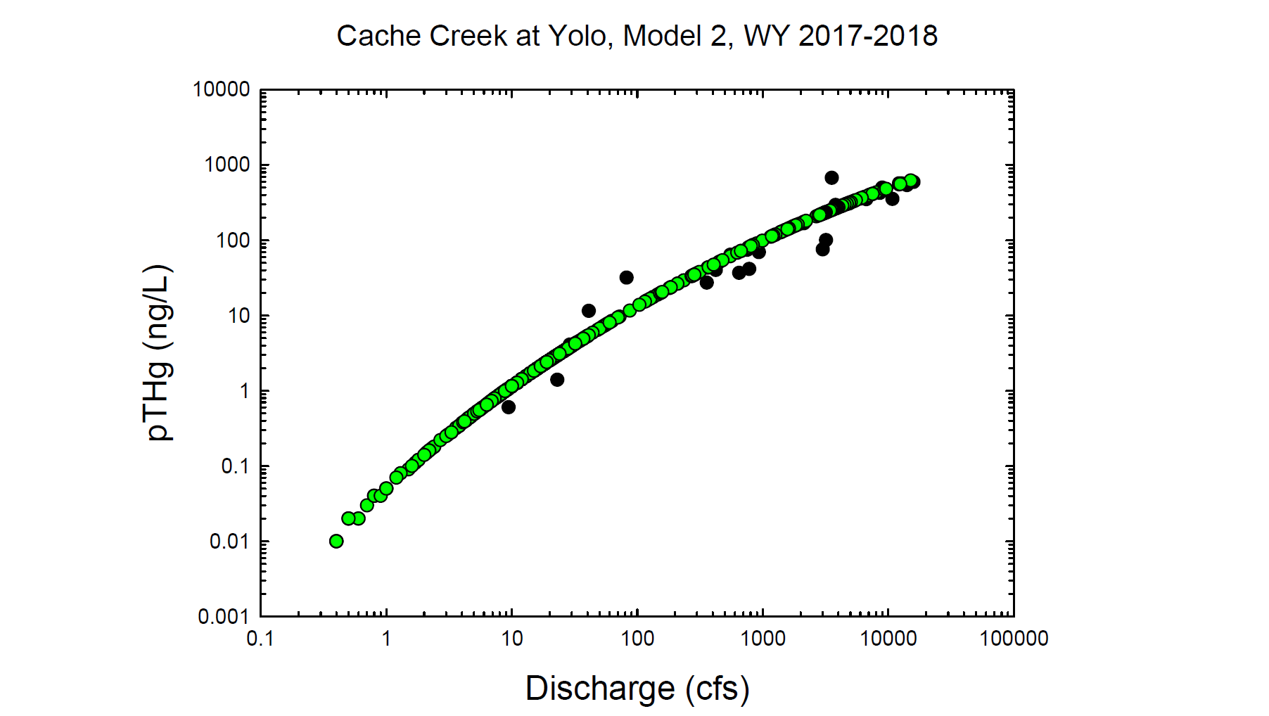
Black circles = Observed values
Green circles = Modeled values

Slide 2
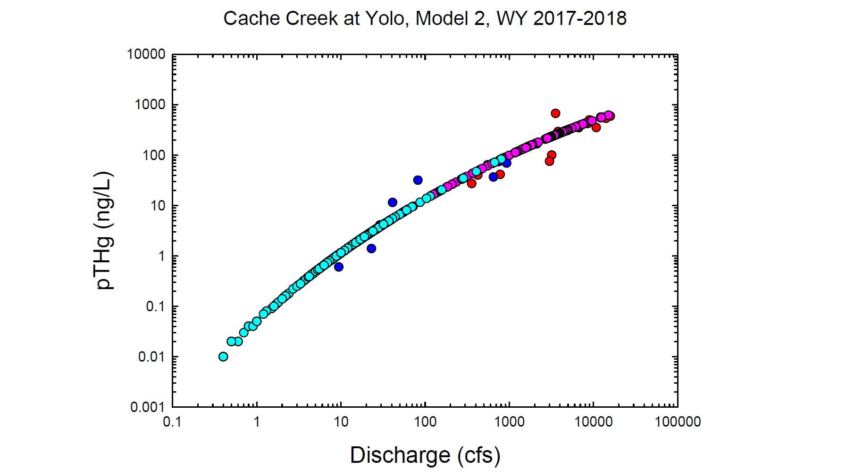
Red = Observed wy2017
Dk. Blue = Observed wy2018
Pink = Modeled wy2017
Lt. Blue= Modeled wy2018

Slide 3
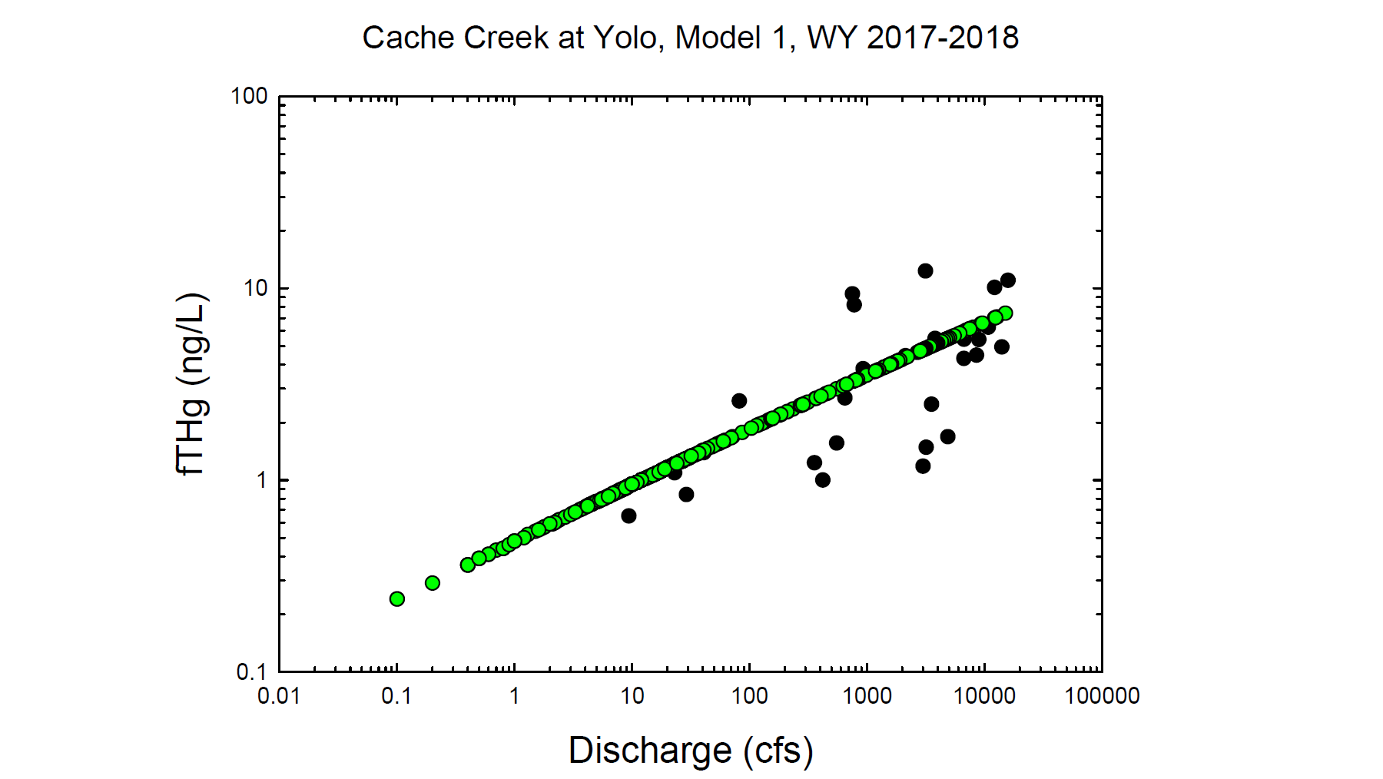
Black circles = Observed values
Green circles = Modeled values

Slide 4
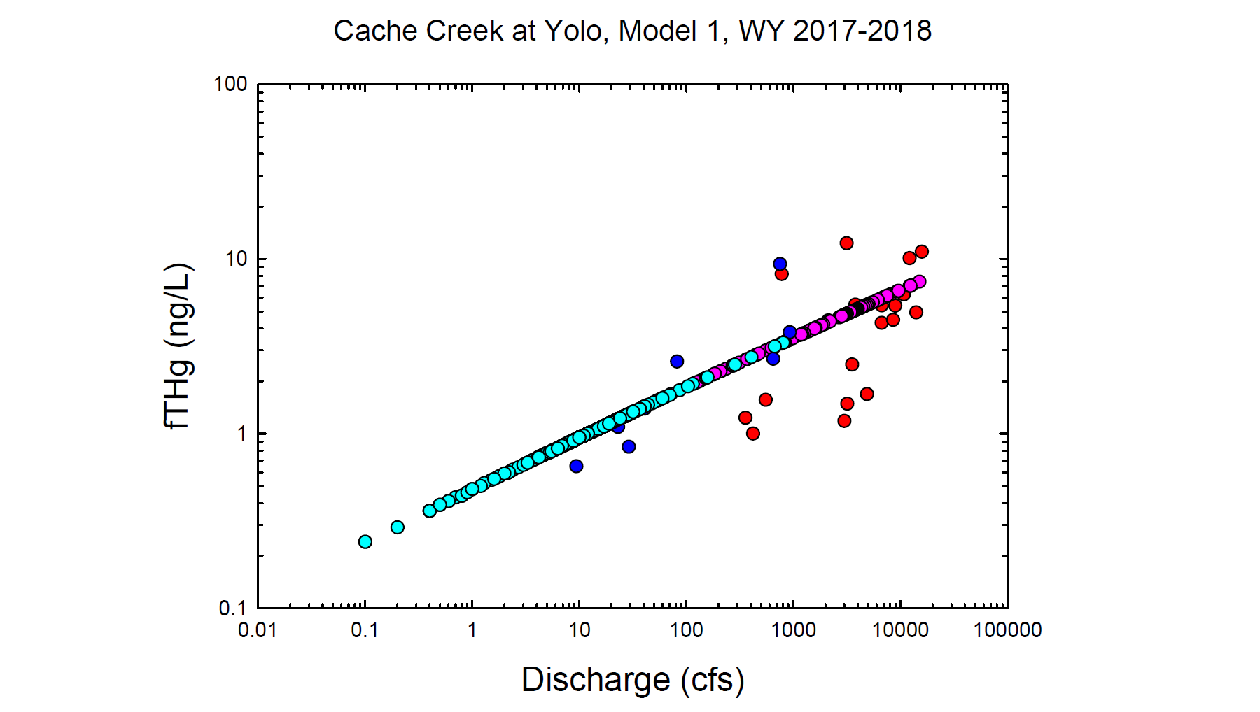
Red = Observed wy2017
Dk. Blue = Observed wy2018
Pink = Modeled wy2017
Lt. Blue= Modeled wy2018

Slide 5
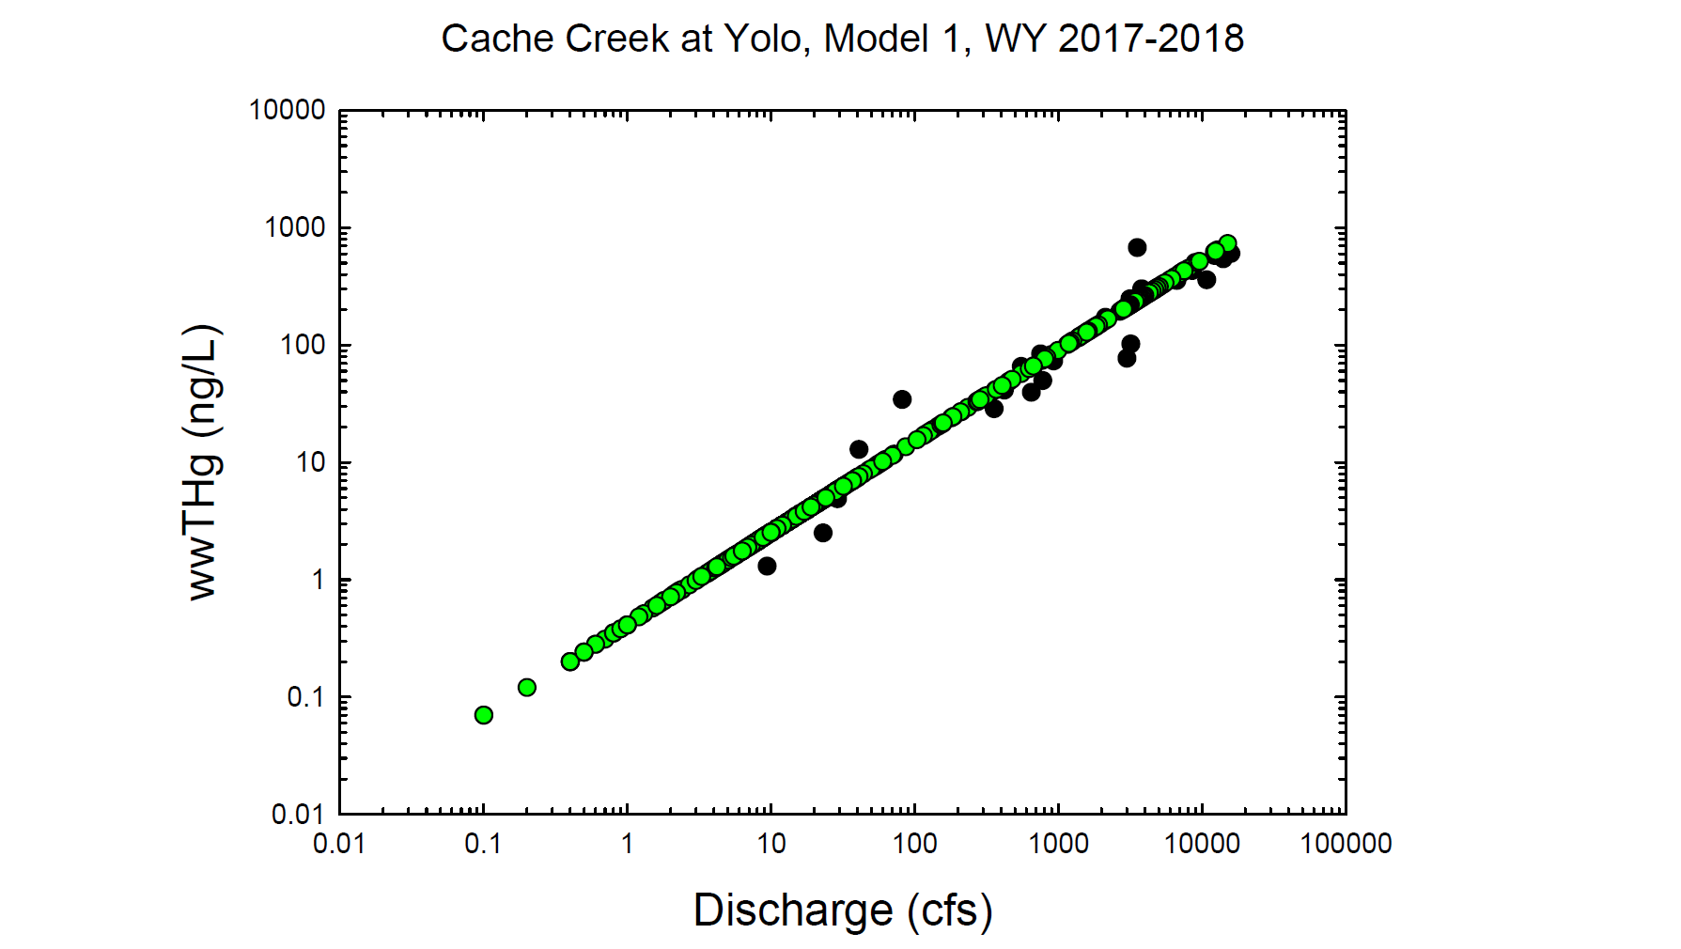
Black circles = Observed values
Green circles = Modeled values

Slide 6
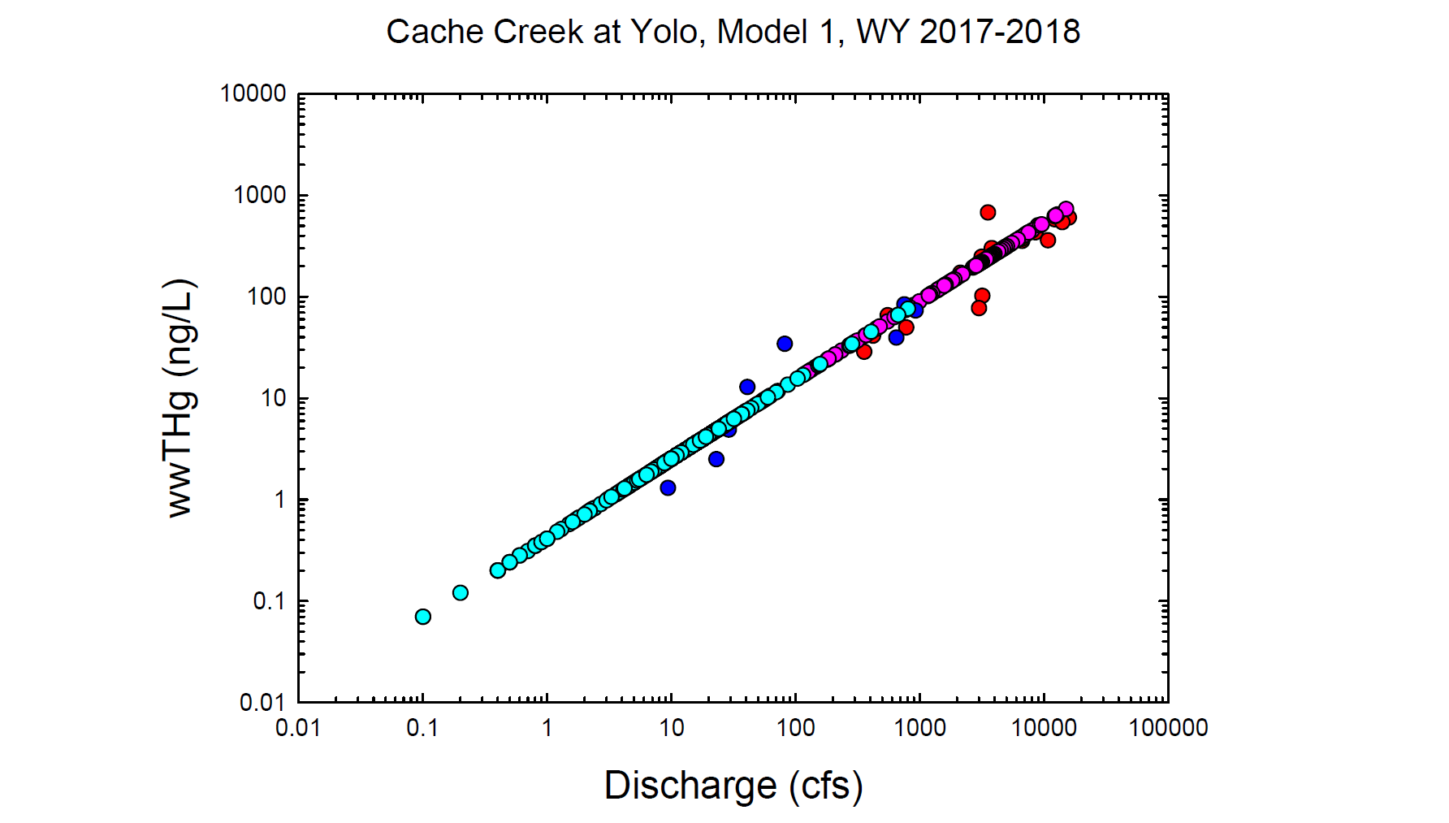
Red = Observed wy2017
Dk. Blue = Observed wy2018
Pink = Modeled wy2017
Lt. Blue= Modeled wy2018

Slide 7
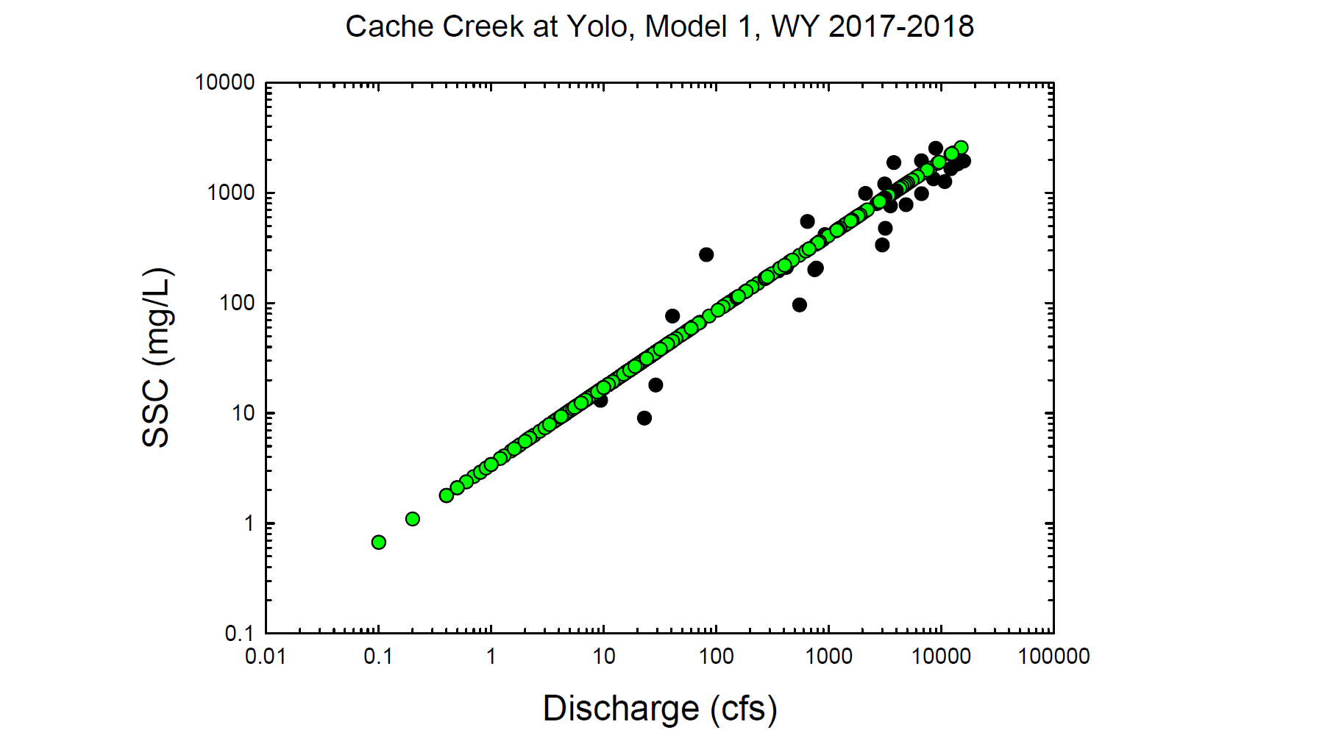
Black circles = Observed values
Green circles = Modeled values

Slide 8
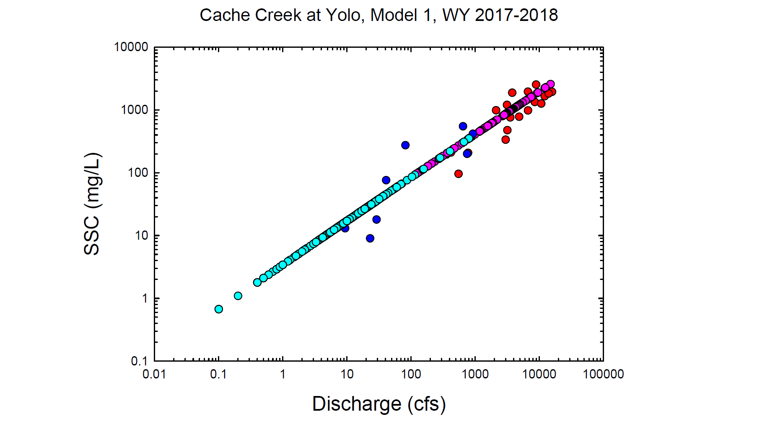
Red = Observed wy2017
Dk. Blue = Observed wy2018
Pink = Modeled wy2017
Lt. Blue= Modeled wy2018

